Slide 1
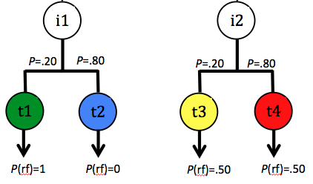
Choice 1:
Choice 2:
Choice 3:
C1
C2
C3
FR1
i1
i2
FR1
P=.20
P=.80
P=.20
P=.80
t1
t2
t3
t4
FT10s
P(rf)=1
P(rf)=0
P(rf)=.50
P(rf)=.50
Notes:
Based on stagner zentall 2010-subotimal choice by pigeons.pdf
-3 choices with fixed spatial location to reduce trial amount. Reversal needed. Counter balance between birds.
-Do we want a reversal in phase 3?

Slide 2
Leads to
Forced Choice
Leads to
Free Choice
C4
C3
FR1
FR1
OR
AND
FT10s
Notes:
Roger’s Idea.

Slide 3
Operant Screen Panel
Grey Circles and squares indicate
inoperative keys and will illuminate
when stimuli are present.
C1, C2, & C3 appear on topmost
squares.
Initial & Terminal links appear in the
lower circles.

Slide 4
Stimuli
Inoperative
Keys
C1 & C2 & C3
Initial Links
Terminal Links

Slide 5
Training
Phase 1:
Autoshape all stimuli in respective locations with FR1 operant contingency built in.
ITI = 240sec
During the ITI the panel will be visible but all keys will be inoperative (i.e., solid grey)
Stimulus Duration = 10sec
Min 90% Accuracy over two days
Phase 2:
Operant Contingency Only
Increase all stimuli from FR1 toFR3 to FR5
ITI = 60sec
Stimulus Duration = 10sec
Min 90% Accuracy over 2 days on FR5

Slide 6
Training
Phase 3:
Do full procedure without C stimuli
40 Forced Choice Trials
20 left & 20 right
Trials:
Four t1 trials
4 reinforced
16 t2 trials
16 not reinforced
Four t3 trials
2 reinforced, 2 not reinforced
16 t4 trials
8 reinforced, 8 not reinforced
20 Choice Trials randomly intermixed

Slide 7
Training
Phase 4 (Testing):
Identical to Phase 3 except…
C stimuli included.
30 forced choice trials (10_{c1} x 10_{c2} x 10_{c3})
Minimum 6 (3!) additional choice trials needed to counter balance sides of C stimuli
Terminal links be chosen pseudo-randomly according to probabilities.

Slide 8
Other
Reversal Condition to assess side bias (Phase 4 – only reinforcement changes)
1 Second of Hopper access
No Start-Stimulus
10 second ITI (test)
1 second addition for terminal links that do not deliver food

